Slide 1
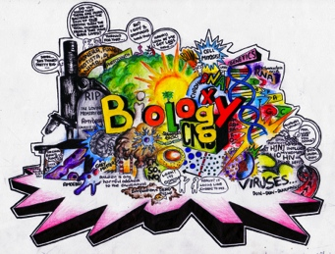

Slide 2
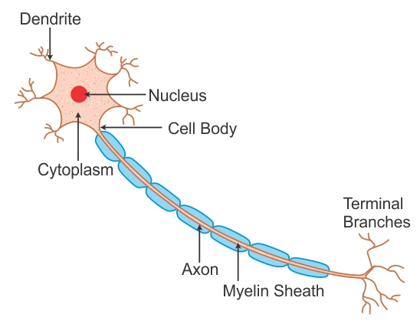
Neurons
Information passes from receptors along cells called neurons.
A neuron is a nerve cell
Nerve cells are long and thin to carry messages called impulses.

Slide 3
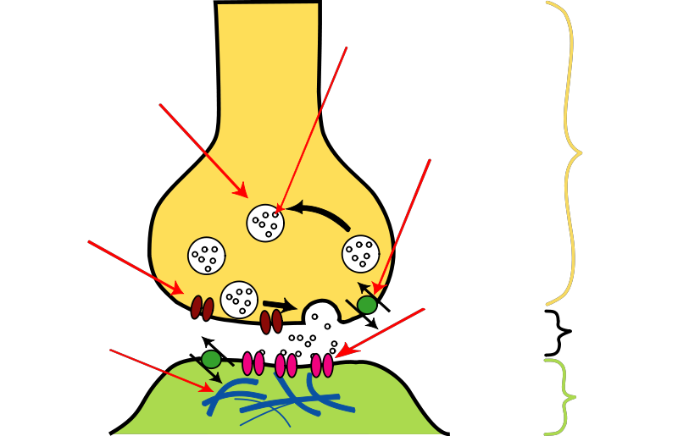
Neurotransmitters
Neurotransmitters are chemicals that transmit signals from a neuron to a target cell across a synapse (gap).

Slide 4
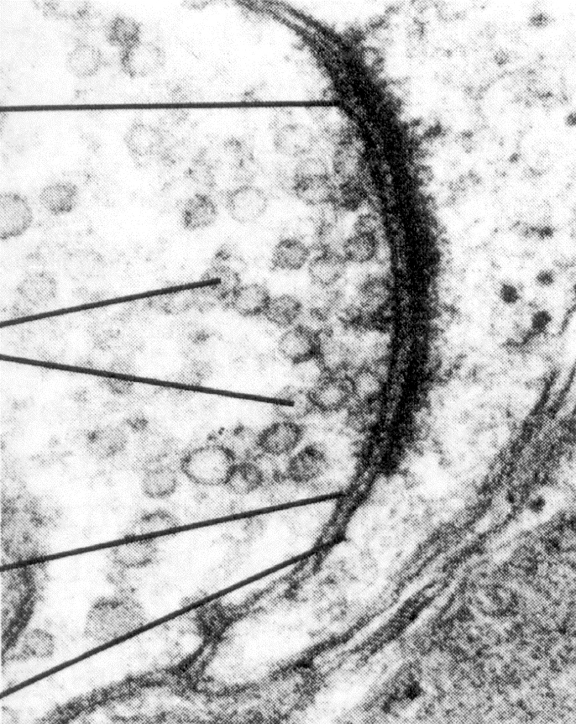
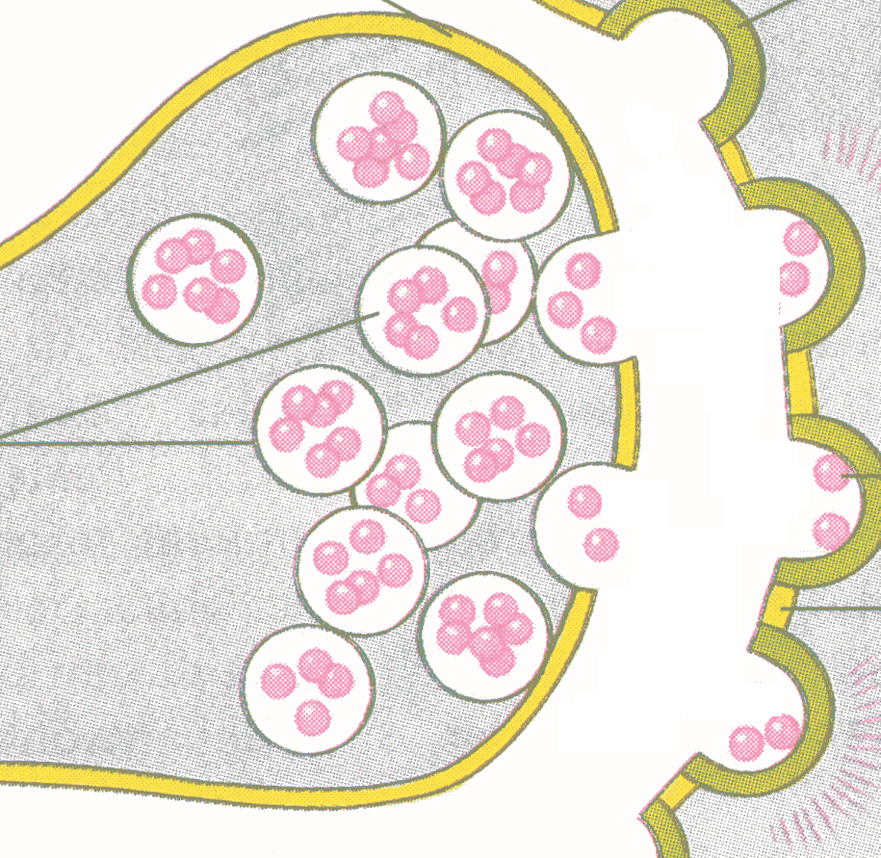

Because neurons never touch, chemical signalers called neurotransmitters must travel through the space called synapse between two neurons.
Neurotransmitters
(pink
spheres)
The message is transferred when RECEPTORS receive neurotrans-mitters.
Synapse (gap)

Slide 5
There are 3 types of neurons:
Sensory neurone – carry impulse from receptor to CNS
Relay – connects sensory to motor
Motor – connects CNS to effector which makes a response. (muscle, gland)

Slide 6

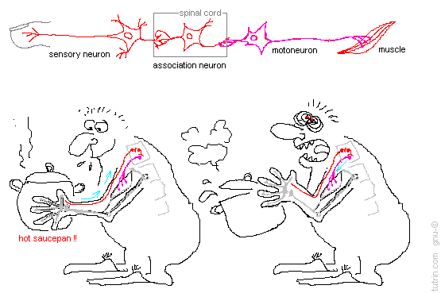
Reflexes

Slide 7
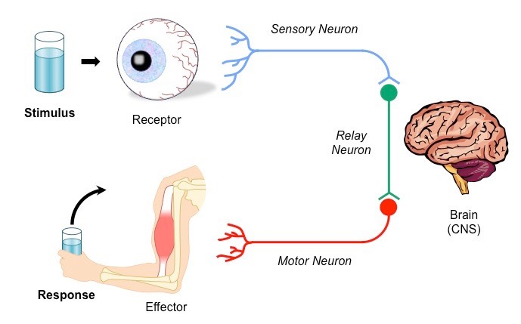
A simple model of your nervous system is a stimulus– response model.
Receptors stimulate the sensory nerves.
The sensory nerves send a message to the brain.
The brain works out the response that is required, then sends a message along motor nerves to the effectors—the muscles or glands that will put the response into effect.

Slide 8
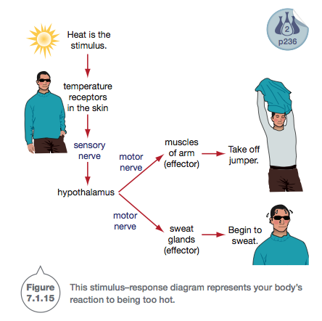

Slide 9
Reflex actions: a rapid response
If you touch something hot or sharp, you automatically pull your hand away.
Arm muscles that are normally under your voluntary control react very fast, without waiting for instructions from the brain.
This action, called a reflex action, protects your body from danger.

Slide 10
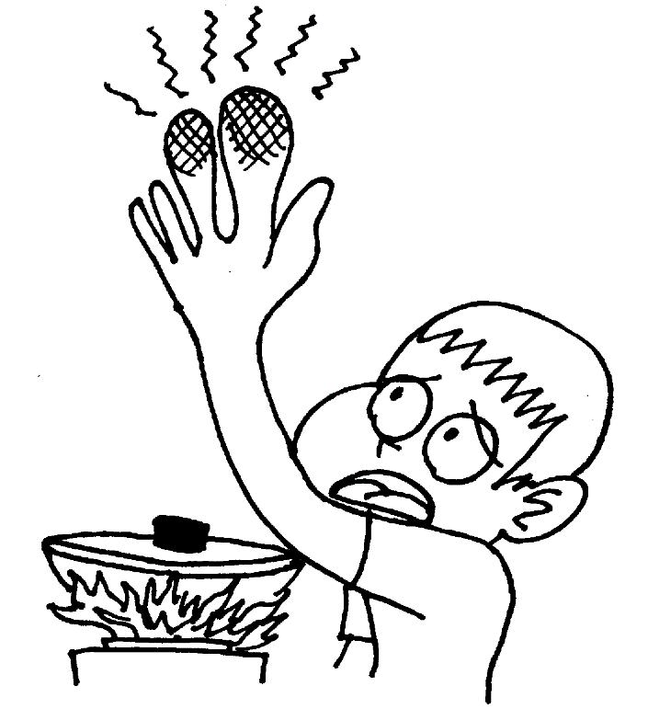
What happens when you touch a hot object?
Receptors detect the temperature of your skin.
This activates a sensory neuron, which sends nerve impulses to the spinal cord.

Slide 11
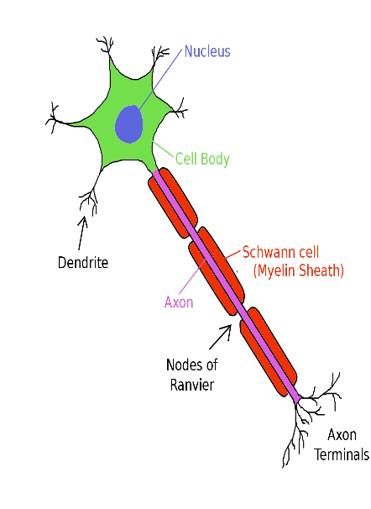
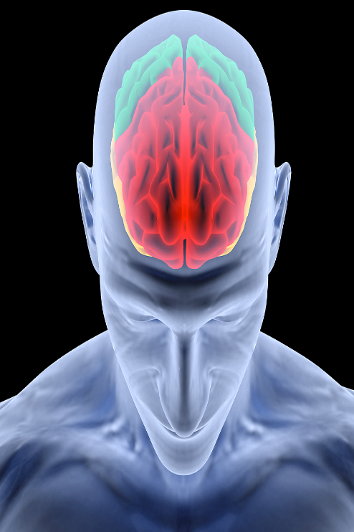
Within the spinal cord, a relay neuron passes the message directly to a motor neuron, which sends impulses to the arm muscles.
The arm muscles contract, lifting your hand away from the hot object.
A message is sent to the brain shortly afterwards.
Only then can the brain register pain. The nerve pathway operating in a reflex action is called a reflex arc.

Slide 12
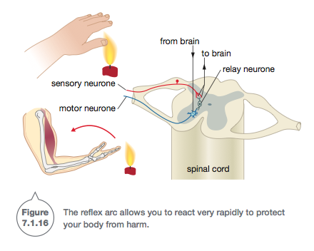
T

Slide 13


